Slide 1
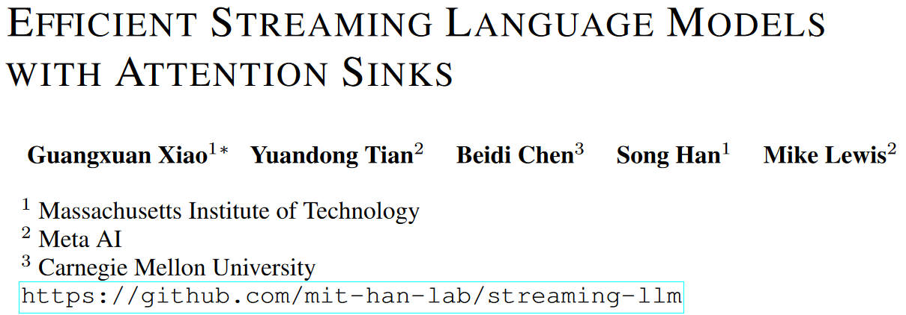
arXiv 2309.17453

Slide 2
Abstract
LLM's challenges in streaming applications, e.g. multi-round dialogue:
Popular LLMs cannot generalize to too long texts.
Too much memory for caching previous tokens' keys and values.
Naive solution: Use window attention, and only cache recent KV.
Drawback: It fails when the text length surpasses the cache size.
Observation: Keep initial token's KV and the performance comes back.
Analysis: It is used as an "attention sink" even if it is unimportant.
Others: We make use of this phenomenon to extend window size.
Spoiler: The model still cannot make use of all tokens.

Slide 3
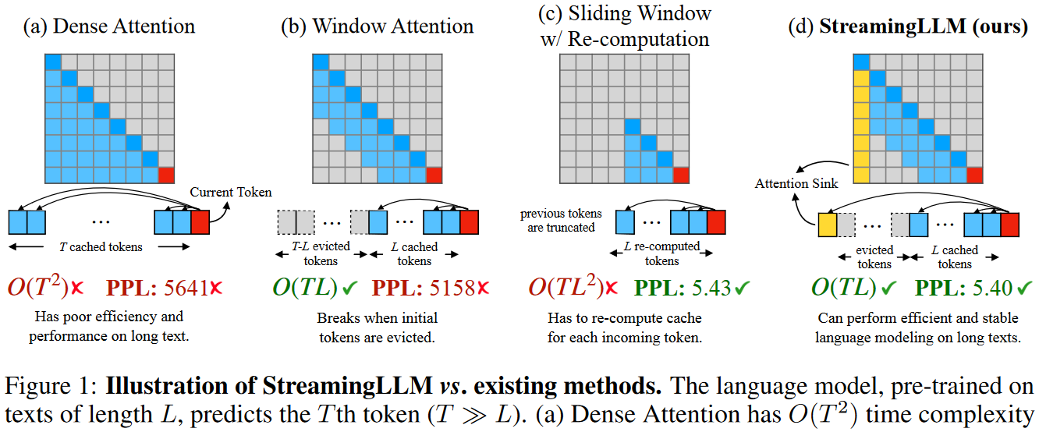
Introduction
LLMs are powerful but they cannot perform long sequence generation.
They are constrained by attention window during pre-training.

Slide 4
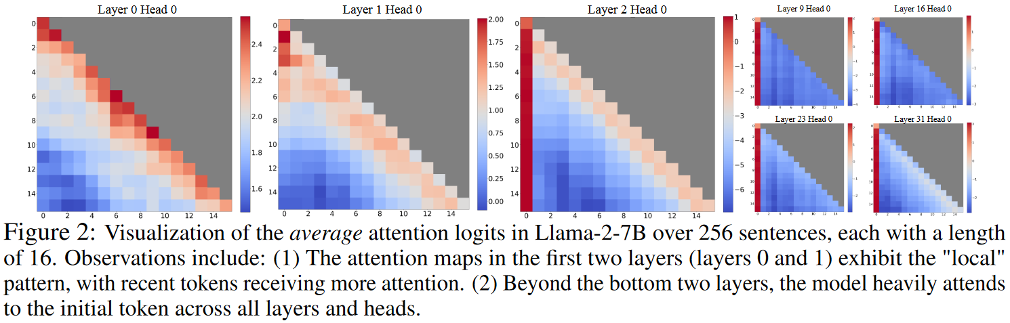
Attention sinks

Slide 5
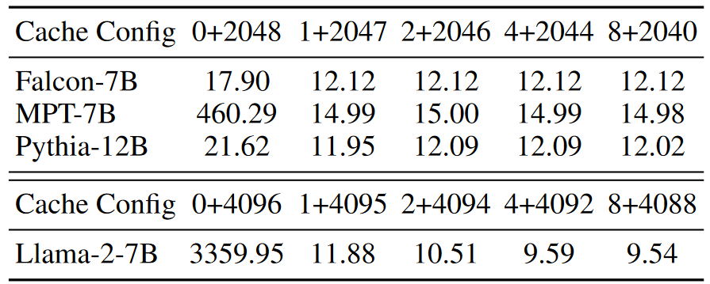
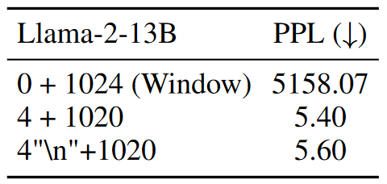

Attention sinks
For layer ≥ 3, initial tokens are consistently focused.
$⟹$Removing initial tokens' KV greatly changes distribution of attention.
Why? Either because of their semantics, OR because of their positions.

Slide 6
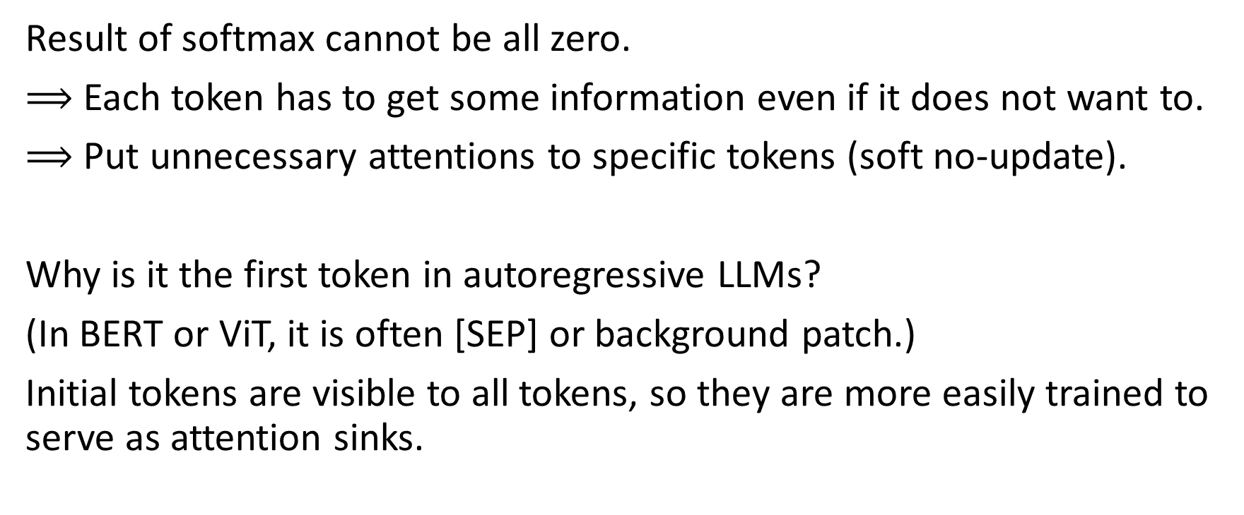
Attention sinks - why?
Result of softmax cannot be all zero.
$⟹$ Each token has to get some information even if it does not want to.
$⟹$ Put unnecessary attentions to specific tokens (soft no-update).
Why is it the first token in autoregressive LLMs?
(In BERT or ViT, it is often [SEP] or background patch.)
Initial tokens are visible to all tokens, so they are more easily trained to serve as attention sinks.

Slide 7
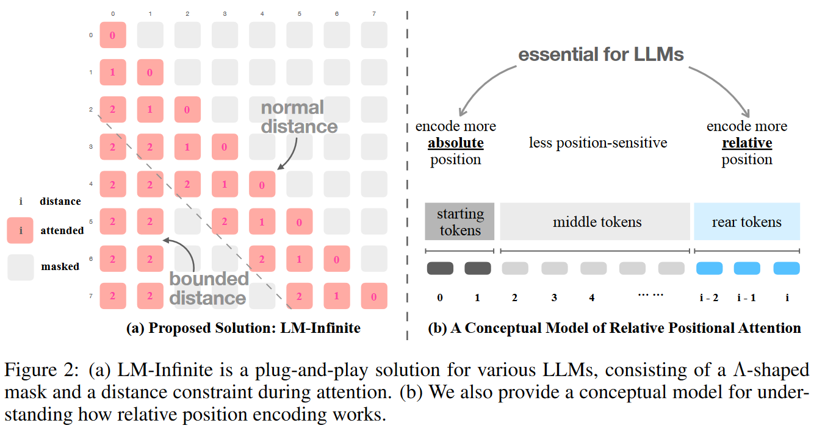
Window attention with attention sinks

Slide 8
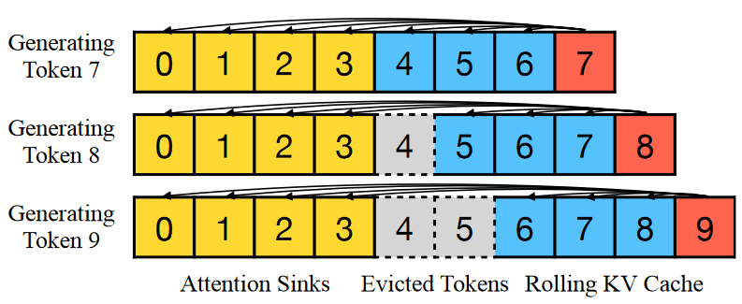
What about position encoding?
In RoPE/AliBi, position encoding is only used in attention calculation.
We apply the position encoding as if they were continuous text.
Position encoding
0
1
2
3
4
5
6
7

Slide 9
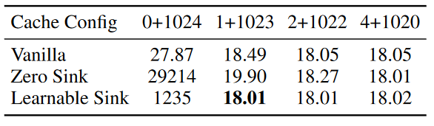
Pre-train LLM with attention sinks
Just apply a consistent "sink token" for LLM in pre-training?
Proposals:
Use a trainable "sink token" (much like [BOS]).
Use a virtual always-zero token as sink? (Suggested by Attention is off by one.)
We train 3 models of 160M param from scratch to find out.

Slide 10
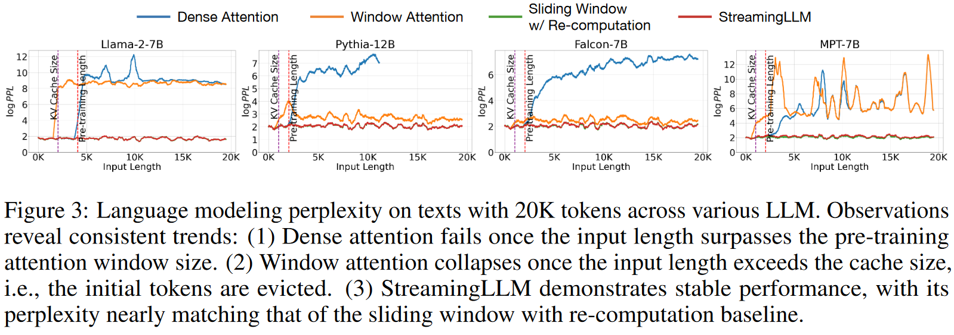
Experiments of StreamingLLM

Slide 11
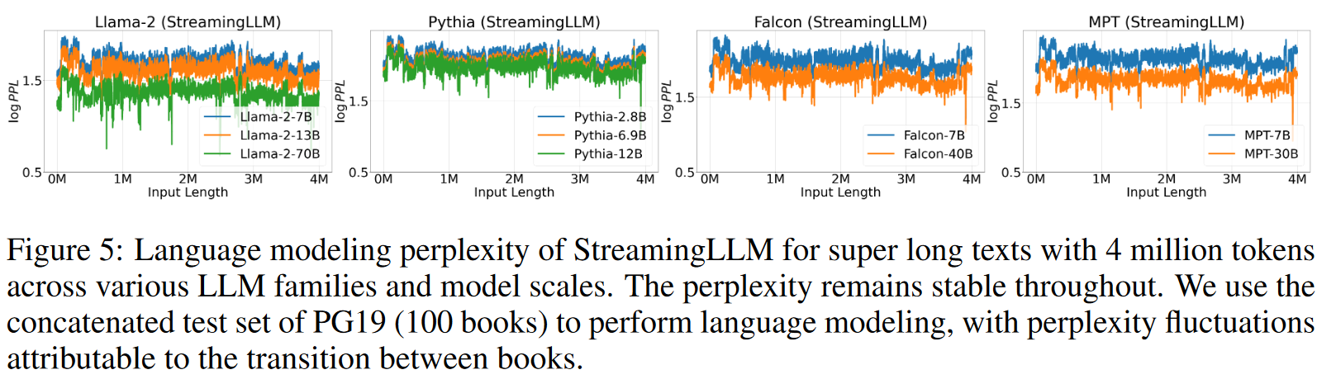
Experiments of StreamingLLM

Slide 12
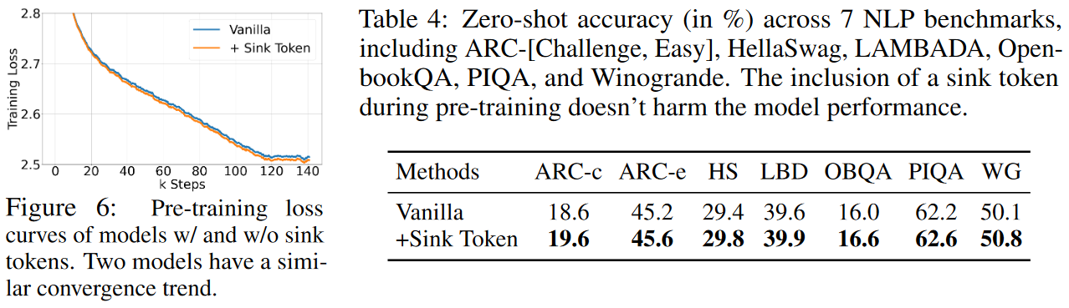
Experiments of pre-training with sink token
Train 2 models of 160M param from scratch with Pythia-160M's recipe on deduplicated Pile dataset for 143,000 steps, respectively.

Slide 13
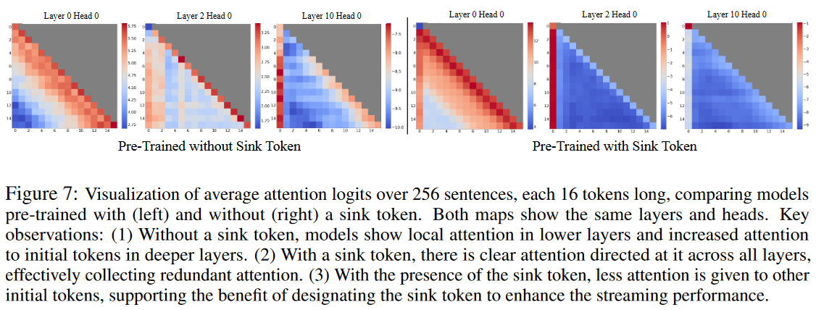
Experiments of pre-training with sink token

Slide 14
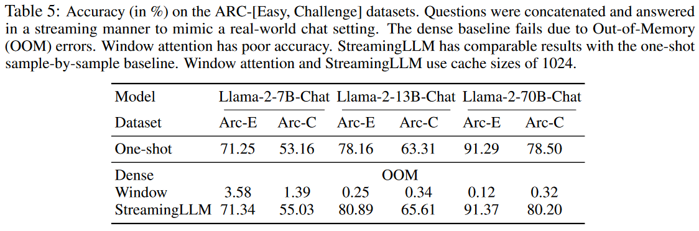
Experiments on streaming QA

Slide 15
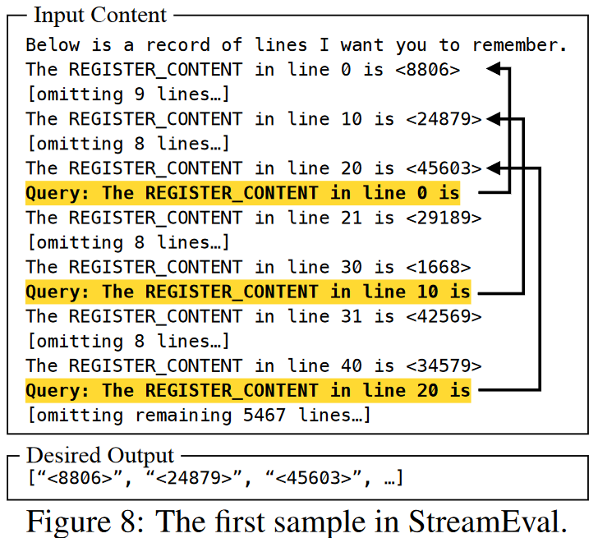
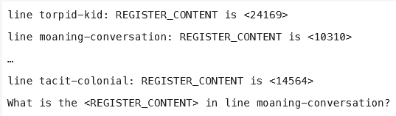
Experiments on StreamEval
We create a dataset, StreamEval, to demonstrate a streaming scenario.
The answer is always 20 lines away.
Its style is similar to LongEval.
A LongEval example.

Slide 16
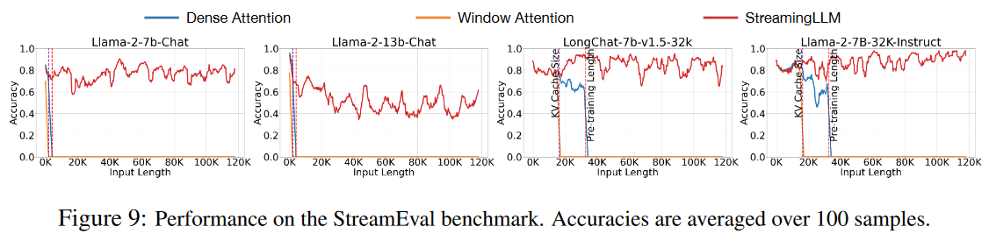
Experiments on StreamEval

Slide 17
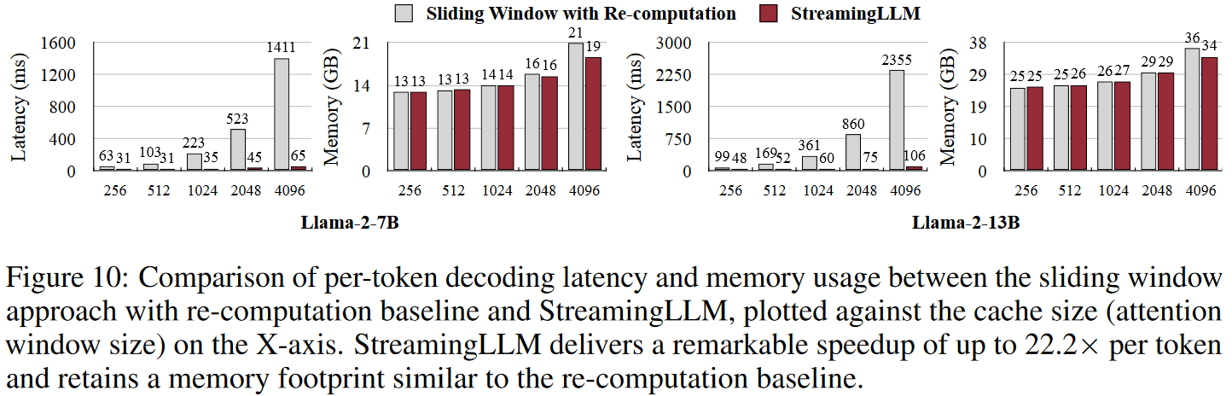
Efficiency results

Slide 18
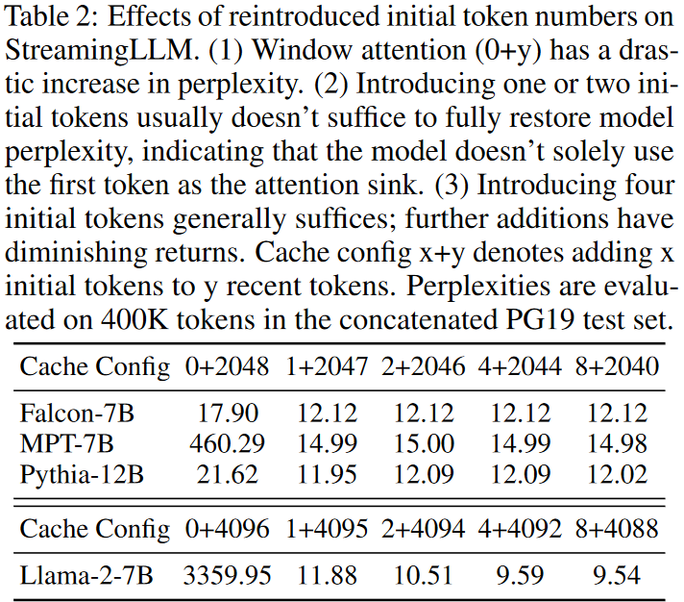
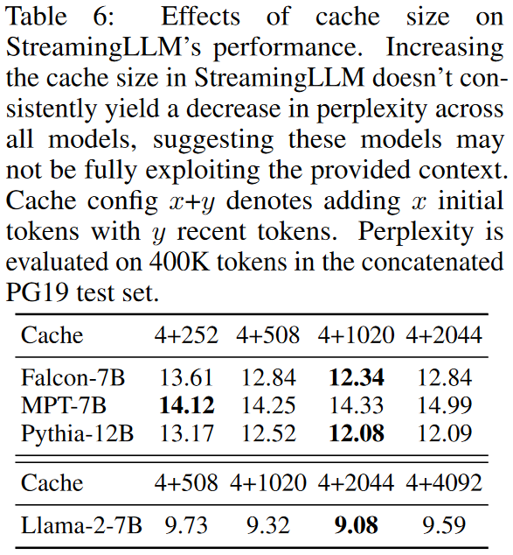
Ablation Study

Slide 19
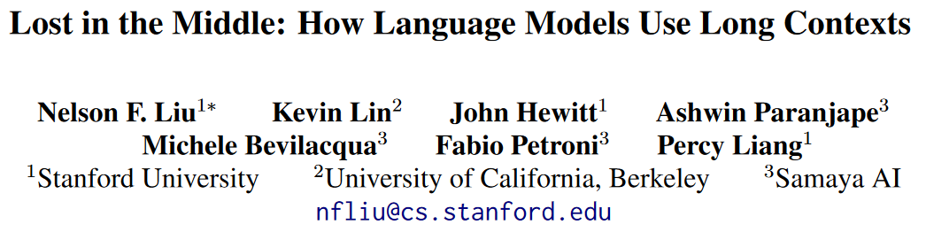
Related work
arXiv 2307.03172.

Slide 20
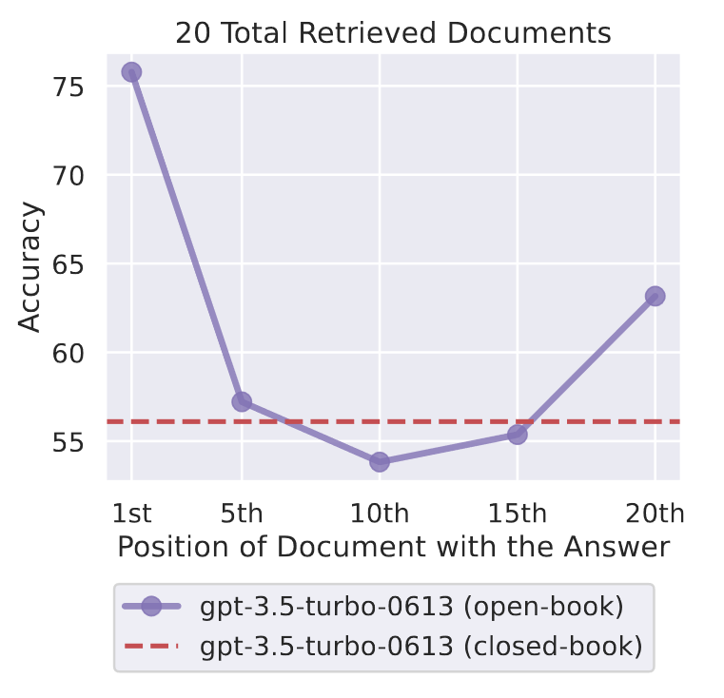
Related work - Lost in the Middle: ...

Slide 21
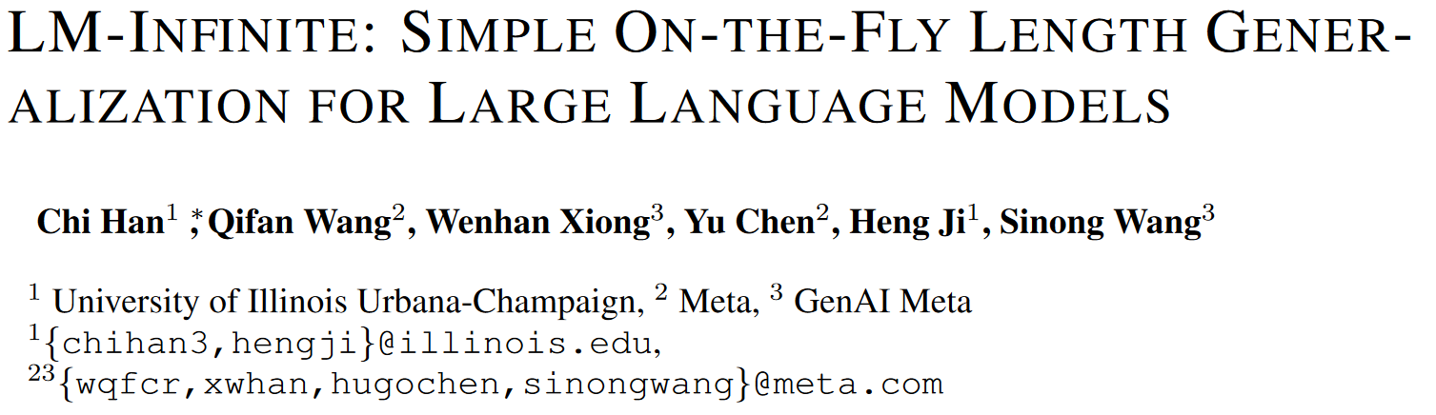
Similar work
arXiv 2308.16137.

Slide 22
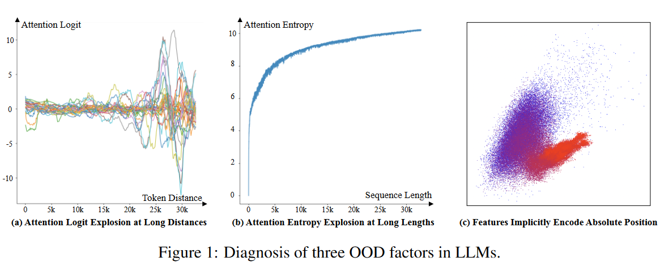
Similar work - LM-Infinite: ...
Theorem: There exists a parameterization for a vanilla self-attention layer such that its output feature on an input sequence without positional encoding can recover absolute positions.

Slide 23
Similar work - LM-Infinite: ...
Theorem: There exists a parameterization for a vanilla self-attention layer such that its output feature on an input sequence without positional encoding can recover absolute positions.
(Proved in The impact of positional encoding on length generalization in transformers, arXiv 2305.19466.)
PCA projection of hidden states from the first layer of LLaMA. Dots correspond to the first 4096 tokens in 32 sequences. Blue ones are the initial tokens, and red ones are the tail ones.

Slide 24
Similar work - LM-Infinite: ...

Slide 25
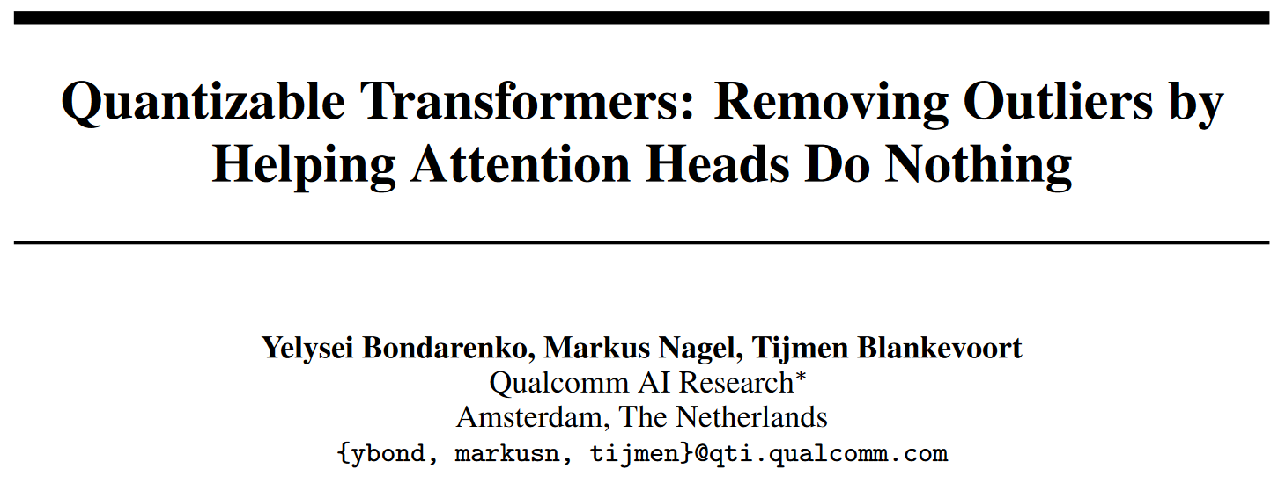
Related work
arXiv 2306.12929.

Slide 26
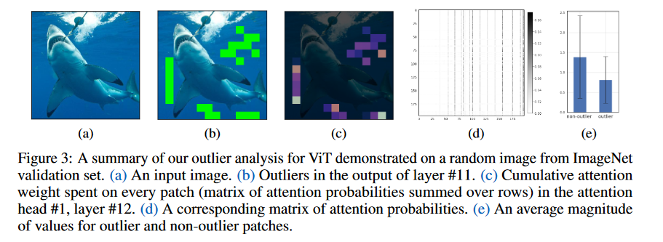
Related work - Quantizable Transformers: ...

Slide 27
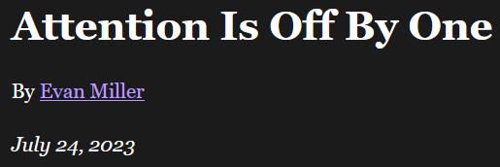
Related work
https://www.evanmiller.org/attention-is-off-by-one.html

Slide 28
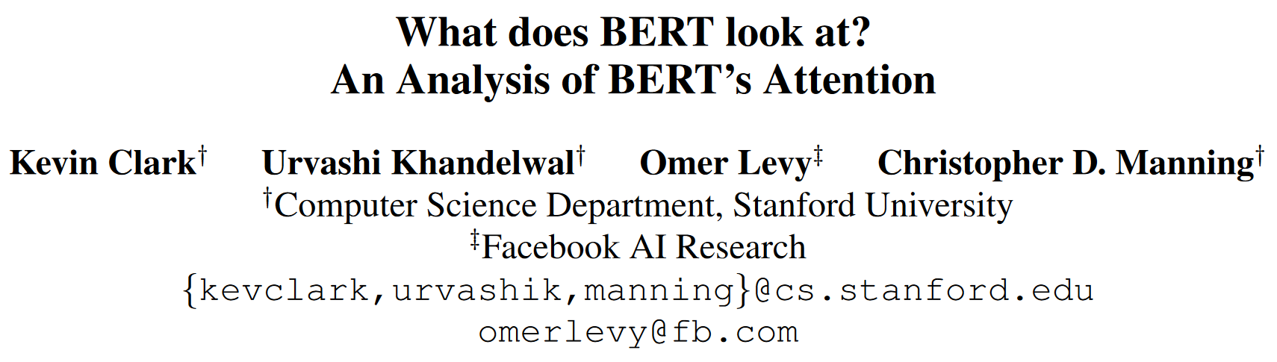
Related work
2019 ACL Workshop BlackboxNLP: Analyzing and Interpreting Neural Networks for NLP.

Slide 29
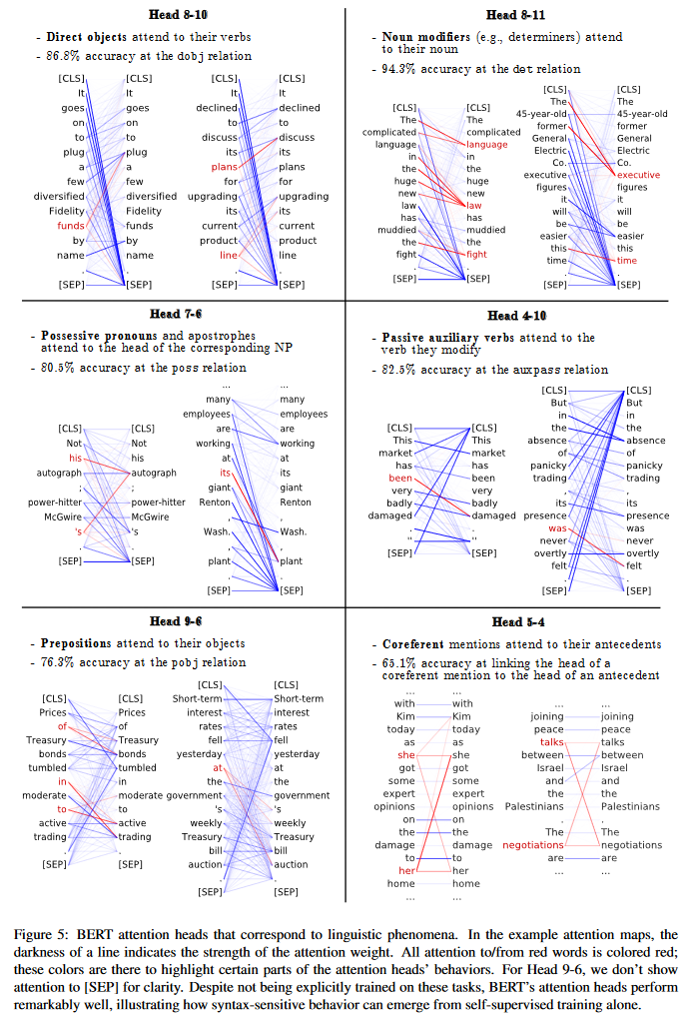
Related work - What does BERT look at? ...
[SEP] is used as a soft "no-op".

Slide 30
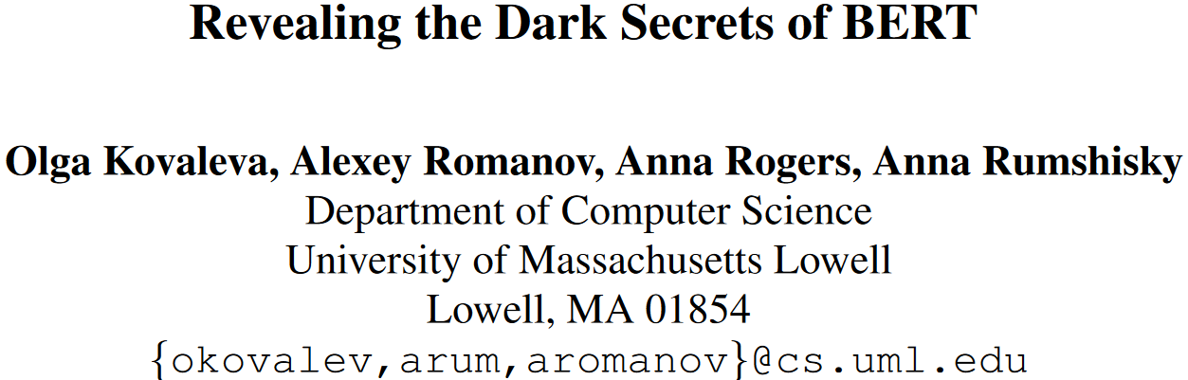
Related work
EMNLP 2019.

Slide 31
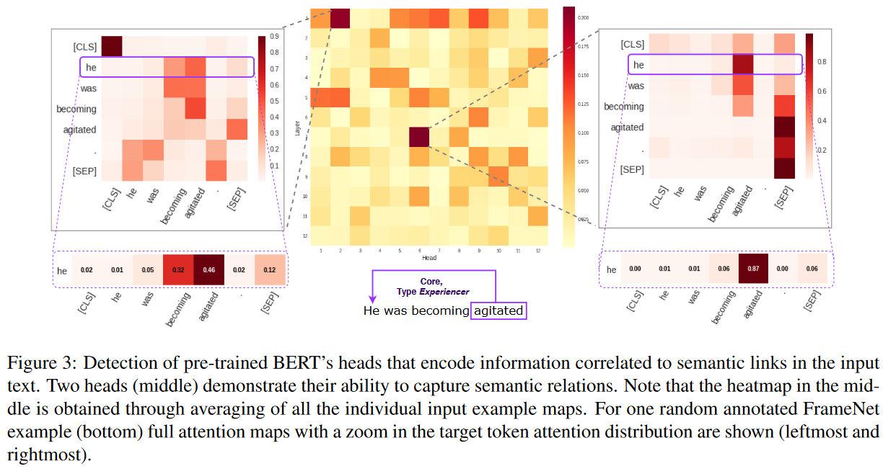
Related work - Revealing the Dark Secret...
Most attentions come to [CLS] and [SEP].
Also note that punctuations have a similar function.

Slide 32
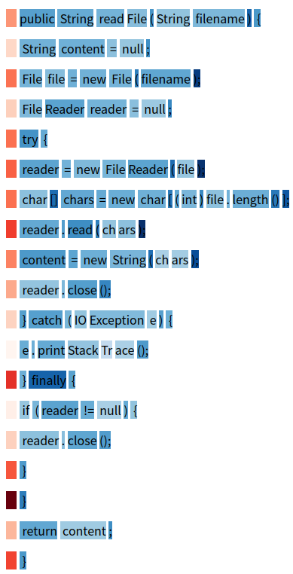
Was a mystery to me...
CodeBERT's attention distribution on a random sample.

Slide 33
Related work - Outliers in Transformer
Appear regularly and consistently across multiple layers and data sequences for many tasks, training objectives and models.
Play a crucial role in the model predictions and clipping them significantly degrades the model task performance.
Only in a small fixed set of embedding dimensions.
Strongest in magnitude outliers typically appear at the output of the feed-forward network, FFN, but for big enough transformer-based language models they start appearing after every linear layer, including query, key, and value projection layers.

Slide 34
Ends.

